Slide 1
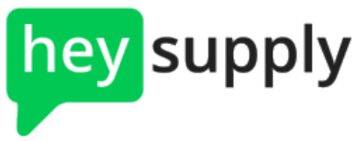
Inventory management system
By – Jyoti Nikam, Snehal Jadhav, Tejas Ghalsasi, Sumant hegde, John Hunsaker
CPSC546 – Modern software management
Instructor – Dr. Lidia Morrison

Slide 2
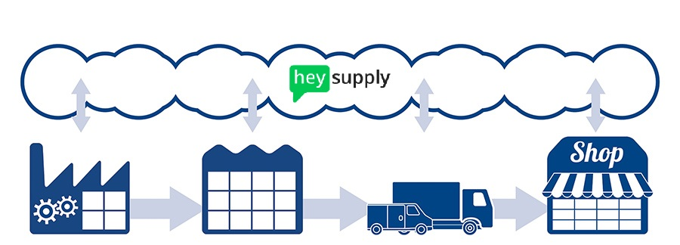
Application goal
The “Hey Supply” Inventory Management System is designed to allow a business to seamlessly and easily use the power of the cloud to keep track of inventory intake, storage, and usage.

Slide 3
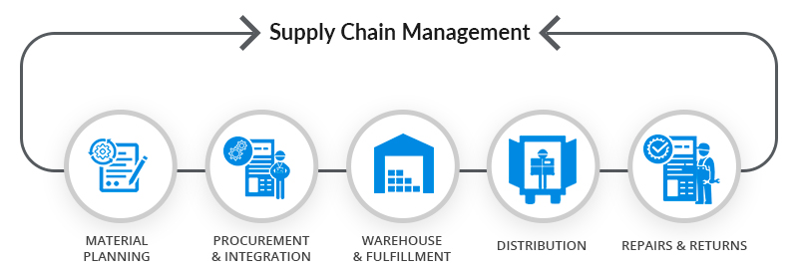
Why is this application needed?
A system to track the logistical actions of a company forms the backbone of any profitable business, and this system succeeds in coalescing all the needed core functions into a simple yet elegant web application.

Slide 4
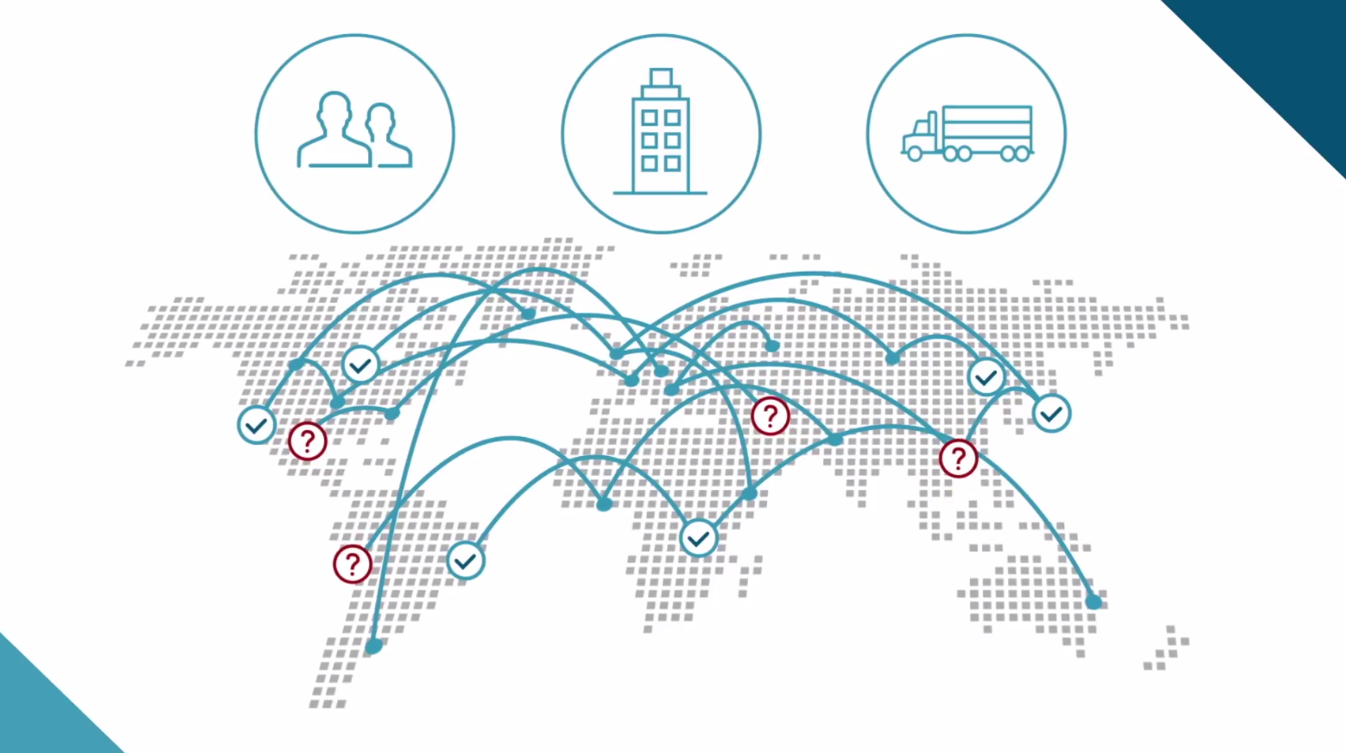
How does “Hey Supply” stand out?
This system is extremely versatile because it can manage different sizes, locations, and types of inventory, including products being shipped or distributed, manufactured, or inventory to support business overhead such as capital purchases and office assets.

Slide 5
Languages and technologies used
HTML, CSS, AngularJS
Node.js, JBoss
H2 Database
Tableau Server
Eclipse IDE, Atom IDE
GitHub, Slack

Slide 6
demonstration

Slide 7


Are there potential future improvements?
This system has the capacity to holistically manage most supply chain and operations functions for a small or large business. It has shown the ability to simultaneously maintain scalability, efficiency, and seamless performance with high visual refinement.

Slide 8
Future work
Next steps might include the addition of a “Catalog” module.
This would enable the user to view and edit lists of templates for units of measurement, item types, and warehouse locations. The user might also have the capability of adding new templated types.
Once saved, these templates could then appear in dropdown menus in the fields in the “Inventory” module, which would serve to limit and control the user’s input to pre-authorized options.

Slide 9
references
Highsmith, James A. Agile Project Management: Creating Innovative Products. Addison-Wesley, 2009.
http://www.zetes.com/en/news/zetes-collaborative-supply-chain-suite-six-solutions-to-drive-process-optimisation-and-achieve
http://shafeelaw.com/supply-chain-management/
http://www.dnb.com/solutions/supply-chain-management.html
http://www.h2database.com/html/main.html
https://www.tableau.com/trial/tableau-server
https://www.inflowinventory.com/software-features
https://www.eclipse.org/downloads/packages/eclipse-ide-java-ee-developers/oxygen1a
flight-manual.atom.io/using-atom/sections/atom-packages/
https://angular.io/resources
http://www.industryweek.com/supply-chain/supply-chain-technology-brings-world-closer-together
https://github.com/
https://getbootstrap.com/

Slide 10
Thank you

